Slide 1
Introduction to Data Science Data Mining for Business Analytics
Brian d’Alessandro
VP – Data Science, Dstillery
Adjunct Professor, NYU
Fall 2014
Fine Print: these slides are, and always will be a work in progress. The material presented herein is original, inspired, or borrowed from others’ worl. Where possible, attribution and acknowledgement will be made to content’s original source. Do not distribute, except for as needed as a pedagogical tool in the subject of Data Science.
Notes:
https://www.youtube.com/watch?v=aMDe5pODkB0 (harlan harris)

Slide 2
Data mining process overview

Slide 3
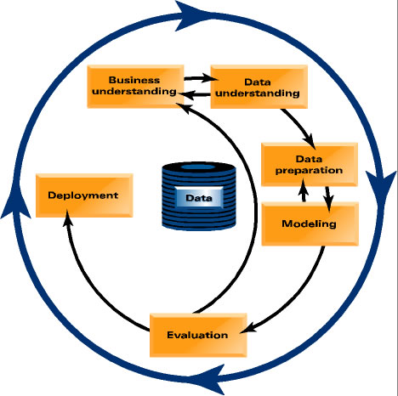
Data mining process
Cross Industry Standard Process for Data Mining
Notes:
Do something more illustrative than a table.

Slide 4

Project/business understanding
Put the problem into context…ask questions…be creative!
Be prepared to ask…
What is the goal of the solution?
Why do we need to do this?
What data is available?
What constraints exist?
What is an acceptable solution?
How do we measure?
What is success?
Exec
Sales
Marketing
Technology
Operations
Notes:
Do something more illustrative than a table.

Slide 5


translate
Data Scientists speak a different language, and you need to be able to translate. This means formulating business objectives in the language of data science.
Let me test whether or not adding incremental data assets improves the lift of our models. I can then measure the net economic benefit and normalize by cost.
We should invest in more data, but only if it drives positive ROI!
Tom P, CEO Dstillery
Data Scientist
Notes:
Do something more illustrative than a table.

Slide 6
Types of Data Mining Tasks
Supervised Learning (aka predictive modeling) involves estimating some quantity Y using predictors X.
Will customer X churn next month/default on her loan?
How much would prospect X spend?
Who might be good “friends” on our social networking site?
Did X cause Y to happen?
What should you recommend to user I.
6
Notes:
6

Slide 7
Types of Data Mining Tasks
Unsupervised learning has many sub-classes and though quantitative, is more subjective in its evaluation.
Recommendation (a.k.a. Collaborative Filtering) What items are commonly purchased together?
Similarity Matching What other companies are like our best small business customers?
Description/Profiling What does “normal behavior” look like? (for example, as baseline to detect fraud)
Clustering Do my customers form natural groups?
7
Notes:
7

Slide 8
Tips for problem formulation
1. Break problem into smaller problems
Example:
Business goal – get the highest net donations from a mail solicitation campaign.
Notes:
Do something more illustrative than a table.

Slide 9
Tips for problem formulation
1. Break problem into smaller problems
Example:
Business goal – get the highest net donations from a mail solicitation campaign.
DS Problem Formulation: Maximize Net Revenue
i.e., Maximize SUM ( E[Donation|Solicitation] – Cost[Solicitation] )
Notes:
Do something more illustrative than a table.

Slide 10
Tips for problem formulation
1. Break problem into smaller problems
Example:
Business goal – get the highest net donations from a mail solicitation campaign.
DS Problem Formulation: Maximize Net Revenue
i.e., Maximize SUM ( E[Donation|Solicitation] – Cost[Solicitation] )
Strategy
Decompose E[D|S] to E[D|Response,X]*P(Response|X)
Build two separate models, E[D|Response,X] & P(Response|X)
Validate and deploy
Notes:
Do something more illustrative than a table.

Slide 11
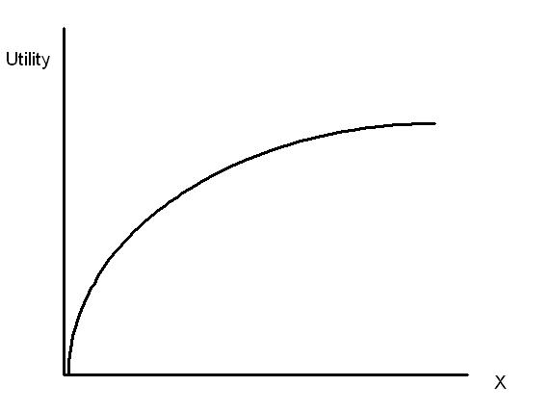
Tips for problem formulation
2. Iterate as much as possible
Keep the problem simpler at first, add more to it later.
A good but simple model is always better than no model!
Bias yourself towards deployment when competing against time.
Model Complexity and
Effort Building/Implementing
Notes:
Do something more illustrative than a table.

Slide 12
Data
Clearly the most important topic yet…
Rules of thumb
Know where your data comes from.
Know how to get the data.
Know what your data looks like.
Know the limits of your data.
Don’t worry, we will cover this topic extensively!
Notes:
Do something more illustrative than a table.

Slide 13
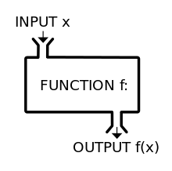
modeling
The engine of data science.
Modeling is how you get from data to insights and decision making.
We will cover how this is done extensively in this course.
Notes:
Do something more illustrative than a table.

Slide 14
evaluation
The safety net of data science.
Evaluation should be built in automatically to the modeling process.
Training Data
In Sample,
Out of Time
User Index
Out of Sample,
InTime
Out of Sample,
Out of Time
Time Index
Throughout this class we will learn various evaluation methodologies along with some of the theory as to why proper evaluation is critically important.
Notes:
Do something more illustrative than a table.

Slide 15


deployment
Your model and analysis are nothing without action.
When your model is shipped to a production system:
Don’t walk away – your model isn’t what you think it is, its what the developer thinks it is.
You are the steward and caretaker. Be proactive about QA and regular performance monitoring.
When your analysis is delivered to people
Communication is everything
Use data to tell a story
Connect your analysis to the audiences’ goals
Collect feedback
Notes:
Do something more illustrative than a table.

Slide 16
Full circle
Once deployed, its not over. Start thinking about the next iteration!
Notes:
Do something more illustrative than a table.

Slide 17

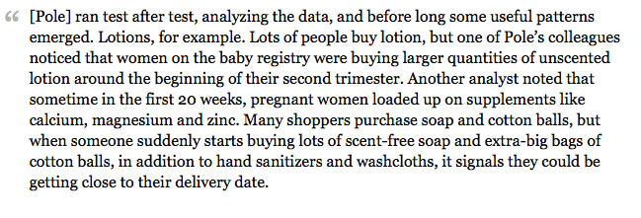
Case study: Target
Who has heard of this case?
Source: http://www.forbes.com/sites/kashmirhill/2012/02/16/how-target-figured-out-a-teen-girl-was-pregnant-before-her-father-did/
Notes:
Do something more illustrative than a table.

